Slide 1
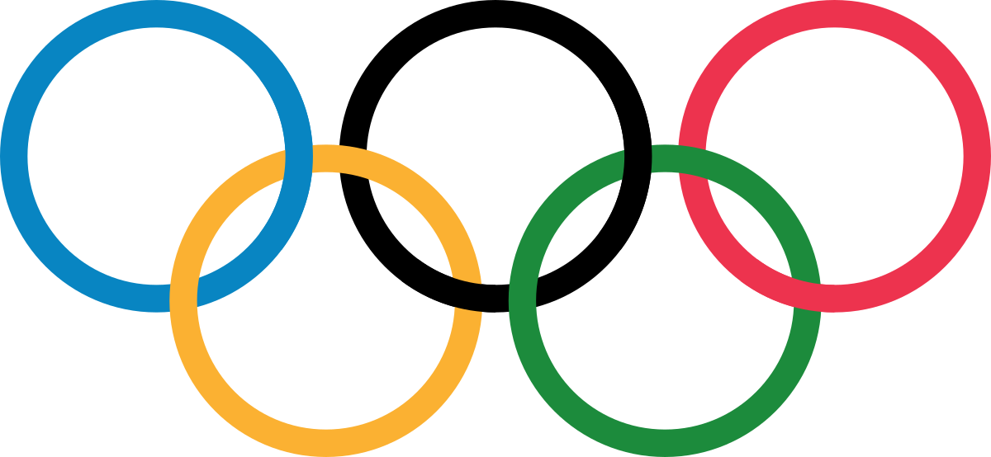
Olympic Athletes
135,571 total athletes since 1896
Total of 271,117 event participations
About 1.6 events per athlete
82.09% summer events
17.91% winter events
39,783 total medals awarded
The United States has competed in 6.95% of the total events
19.54% of athletes that have competed are less than 21
Sport percentages of total events:
Athletics = 14.24%
Gymnastics = 9.85%
Swimming = 8.55%
The oldest person to compete in the olympics was 97 years old. They competed in the 1928 summer olympics in mixed sculpturing art competitions. (only offered in 1928)
The youngest person to ever compete in the olympics was 10 years old. They competed in the 1896 summer olympics in the parallel bars.
306 different events in 2016 Rio
Notes:
29% chance of medal

